Slide 2
Agenda
Introduction
Modules
Components
Overall Architecture
Components Involved
Overall technology Stack
Requirement (Phase 1 and Phase 2)

Slide 3
Introduction
iCare – Enterprise CRM
Modules
Account Administration – Manage accounts, issue and pre-activate new accounts, review customer changes
Gift Payment and Loyalty – Loyalty Reward Capabilities, Gift, payment and loyalty accounts. These accounts are associated with Stored Value Card or Loyalty Card that customer uses at POC
Coupon Administration
Campaigning – Bulk emailing

Slide 4
iCare Programs
Gift and Debit Programs
Credit Card Programs
Coupon Card Programs
Entitled customer to a discount
Free menu item
Mailing Campaign
Rule based
Loyalty Programs
Activity based/Rule Based

Slide 5
Rules
Encourage customer’s specific behavior, such as return visits or purchases of specific items or amounts.
iCare provides rules to define behavior and they are 6 types
Card
Eligibility
Loyalty
Redemption
Load Bonus
Coupon Rules

Slide 6
Programs
Grouping of rules and conditions to apply to various accounts
5 Card program categories
Standard gift card
Points to Dollars
Points to discount
Coupon Award
Discount Award

Slide 7
Cards
Card Applications
Can be used a debit or credit cards
Card Types
iCard
Foreign Cards

Slide 8
myiCard.net
Customer portal which allow them to track the balance and activity of programs associated with their cards

Slide 9
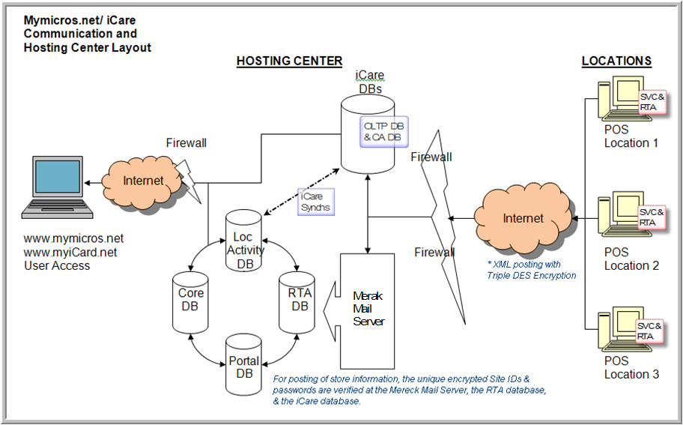
Hosting

Slide 10
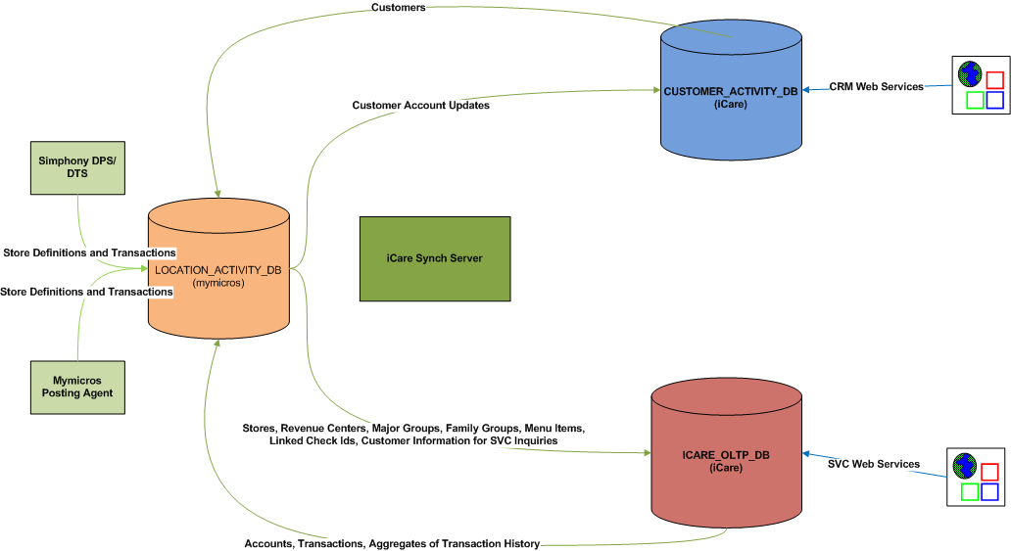
Overall Architecture

Slide 11
Components
Icare_OLTP_DB (High Available Database)
Repository of Icare Configuration Info
account/customer definitions
Transactions
Customer Activity DB (High Available)
Customer Marketing database
Tracks Super set of customer and promotion information
ICare SVC Server
Talks to OLTP DB
Application Server with Web Services (Receives Requests from POS)

Slide 12
Components
ICare DB_Synch
Part of SVC Server which periodically Execute DB-Synch Operations
Synchs between ICARE_OLTP_DB, CUSTOMER_ACTIVITY_DB and LOCATON_ACTIVITY databases
SVC Host Adapter
POS Interface to ICare Server
Deployed on POS
Mymicros.net
Portlet for administrators (iCare Admin functionality)
Relies on OLTP DB, Customer Activity DB, Location Activity DB
Mycard.net
User interface for account holders to review account details

Slide 13
SVC Host Adapter – At POS
Real-time Transfer Agent client is installed on POS Server (SVC Host Adapter)
RES 3700 – SVC To be installed communicated via SIM Script
LES 9700 – Ships with SVC
E7
With Server – Ships with SVC
Standalone – Native Client to communicate

Slide 14
RTA – Remote Transfer Agent
Site
Hosting Center
RTA
inbox
Jobs
Merka
Mail Server
RTA
POP3(110)
SMTP(24)
ACK(jobs)
outbox
sent
SMTP(24)
Totals, Trans, Defs
POS DB
POP3(110)
ACK(ttls, trans)
Posting
Server
Database
SMTP(24)
PING
POP3(110)
ACK(ping)
portaldb
coredb
rtadb
loc_activity_db

Slide 15
RTA
RTA Client is Deployed in POS
It captures transaction information and send as mail to Merka Mail Server
Master Reads the mails and send to RTA Slaves
RTA Slave – Posts the POS data to the ware house

Slide 16
Technology Stack of mymicros

Slide 17
Requirement
Phase 1:
Refactor the code to make it compatible for the Oracle Database
Deploy this version of the code for all new customers
Phase 2:
Create a migration strategy and Implementation for migrating existing customers to Oracle database

Slide 20
Account Administration
Privileged user can
Manage existing accounts
Issue/Bulk Issue new accounts
Pre-activate new accounts
Create card numbers
Review customer changes

Slide 21
ICare OLTP Database
Store Configuration
Organization Information
Store Information
Revenue Centers
Menu Items & Masters
Major Group & Masters
Family Group & Masters

Slide 22
Rules
Card Rules
Card number generation strategy definition
Card rules allow you to set certain attributes for governing each set of cards used with an iCare program
Card rule can be associated with one-to-many relationship
One card rule can be shared across multiple gift and loyalty programs
Eligibility Rule
Behavior of a program
Example
“Require minimum number of items to calculate earning points”

